Slide 1

MAJOR PRESENTATION MENTOR:- DR. RAJESH YADAV
TEAM MEMBERS:-
ABHISHEK SHARMA
ANKUR
AKARSH DUBEY

Slide 2
AIM OF THE PROJECT:-
To conduct dynamic stall characteristics of Low Reynolds Number in Martian Atmosphere in Martian atmosphere……

Slide 3
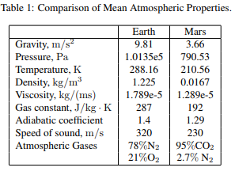
WHY EXPLORE THE MARTIAN SURFACE ?
The complex atmospheric conditions of Martian surface poses certain technical difficulties which needs to be taken into account in deciding the aerodynamic characteristics of the Martian airplane.
For the design of the Martian aircraft a suitable aerofoil needs to be selected that is able to produce sufficient lift to sustain its total weight and that is able to produce high lift to drag ratio (L/D).
In the project we will be dealing with Low Reynolds Number.

Slide 4
INTRODUCTION:-
WHAT IS DYNAMIC STALL?
It is a complex series of events that result in delay in stall on aerofoils or wings.
A non-linear unsteady aerodynamic effect that occurs when airfoils rapidly change the angle of attack.
The rapid change can cause a strong vortex to be shed from the leading edge of the airfoil and increases the lift produced by the wing. As soon as it passes behind the trailing edge, however, the lift reduces dramatically, and the wing is in normal stall.

Slide 5
FACTORS EFFECTING DYNAMIC STALL
The factors such as Reynolds number, Mach number and amplitude affects this complex phenomenon of dynamic stall.
For lower Reynolds number ,we will get laminar separation. In this case the flow separates from the surface of the object as if it is travelling on another surface. This is known as separation bubble in aerodynamics .
In the case of turbulent separation, the air will continue to rotate and stick to the object, separating later. This will delay stall considerably.
Figure 1: Formation of boundary layer due to (a) light dynamic stall (b) heavy stall

Slide 6
Literature Review
Dynamic stall characteristics were studies by Mehta[1] at for NACA 0012 airfoil at Low Reynolds number of the order of 5×10^3 and 10^4 at a reduced frequency of k = 0.25 and 0.50. The oscillatory motion was given by . This was the first numerical simulation of dynamic stall.
Laminar and turbulent incompressible dynamic stall characteristics were also studied numerically by Wu[2] using velocity – vorticity formulation for a NACA 0012 airfoil at reduced frequencies of k=0.1, 0.15 and 0.25. It was concluded that the formation of leading edge vortex is delayed at higher AOA and reduced frequencies.
Dynamic stall characteristics of a SSC- A09 Sikrosky airfoil was also investigated by Ekaterinaris[3] for a turbulent flow using the implicit FDM scheme through Navier – Stokes Equations and turbulence closure was done using Baldwin Lomax algebraic model.

Slide 7
Literature Review
Numerical investigations of dynamic stall at higher Reynold number was also conducted by Fung and Carr [4]. It was concluded that boundary layer separation was delayed at higher AOA and reduced frequency which in in accordance to the results put forth by Wu.
A more recent study was done by Visbal [5], who studied the onset of dynamic stall using high fidelity Implicit Large Eddy Simulations (ILES).

Slide 8
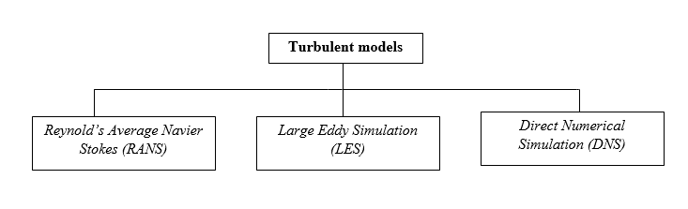
COMPUTATIONAL METHODOLOGY
Most flows in nature and in engineering applications are turbulent. Basically there are three types of models with which can proceed towards our motive.

Slide 9
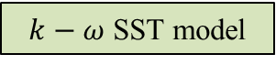
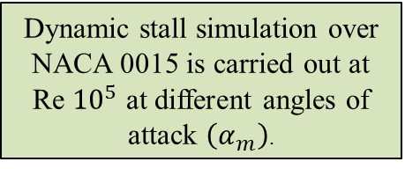
ROADMAP :-
Upwind interpolation (UDS) is used as it satisfies the boundedness criterion unconditionally (no oscillatory solutions)
NACA 0015 airfoil
Turbulence model
(RANS) – Ansys FLUENT
To solve the RANS multi block grid is generated around the airfoil
Discretization is done using the cell centred finite volume approach
$k−ω$SST model
Spalart Allmaras
Through the plots obtained we can investigate the vortex formation on the airfoil the given Reynold’s number and at different AOA.
Pressure contours, velocity contours and streamlines are plotted at Martian conditions and comparison based on various flow parameters, lift and pressure coefficient is made at different AOA.
Dynamic stall simulation over NACA 0015 is carried out at Re ${10}^{5}$ at different angles of attack $\left(α_{m}\right)$.

Slide 10
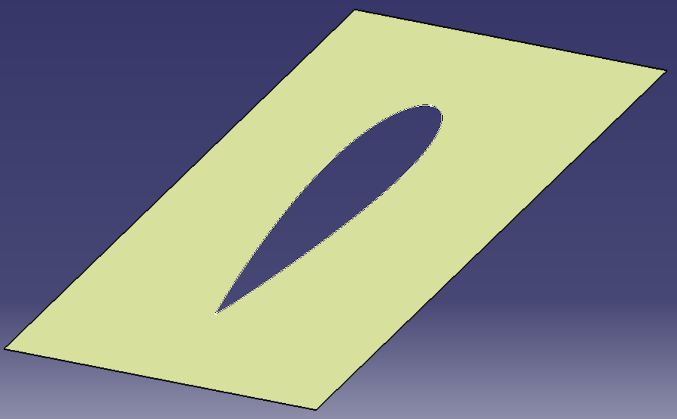
Procedure followed
Creating NACA 0015 airfoil profile in ANSYS Workbench
Meshing
Velocity contours
Solution
Pressure contours
Vorticity contours
NACA 0015 created in CATIA

Slide 11
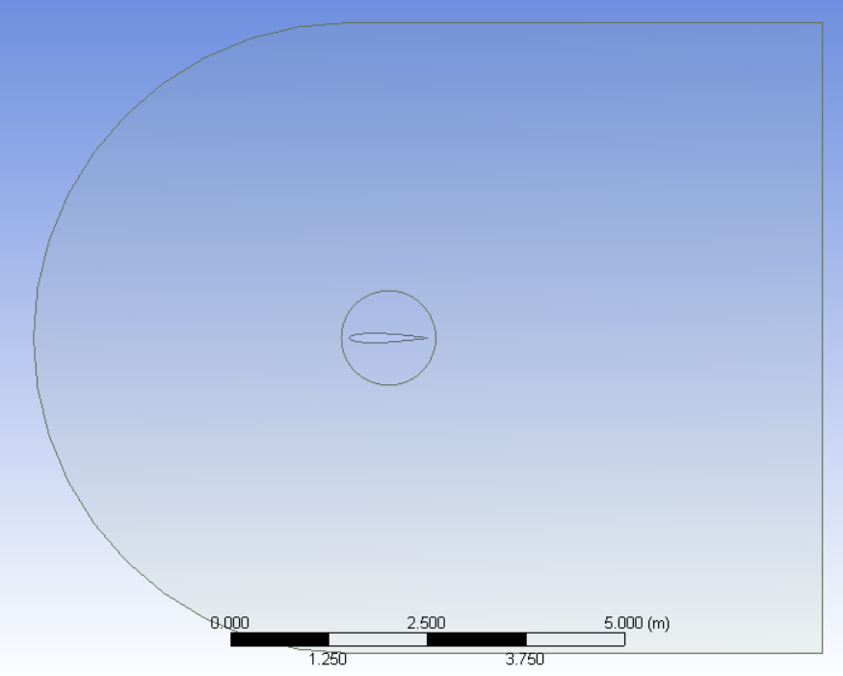
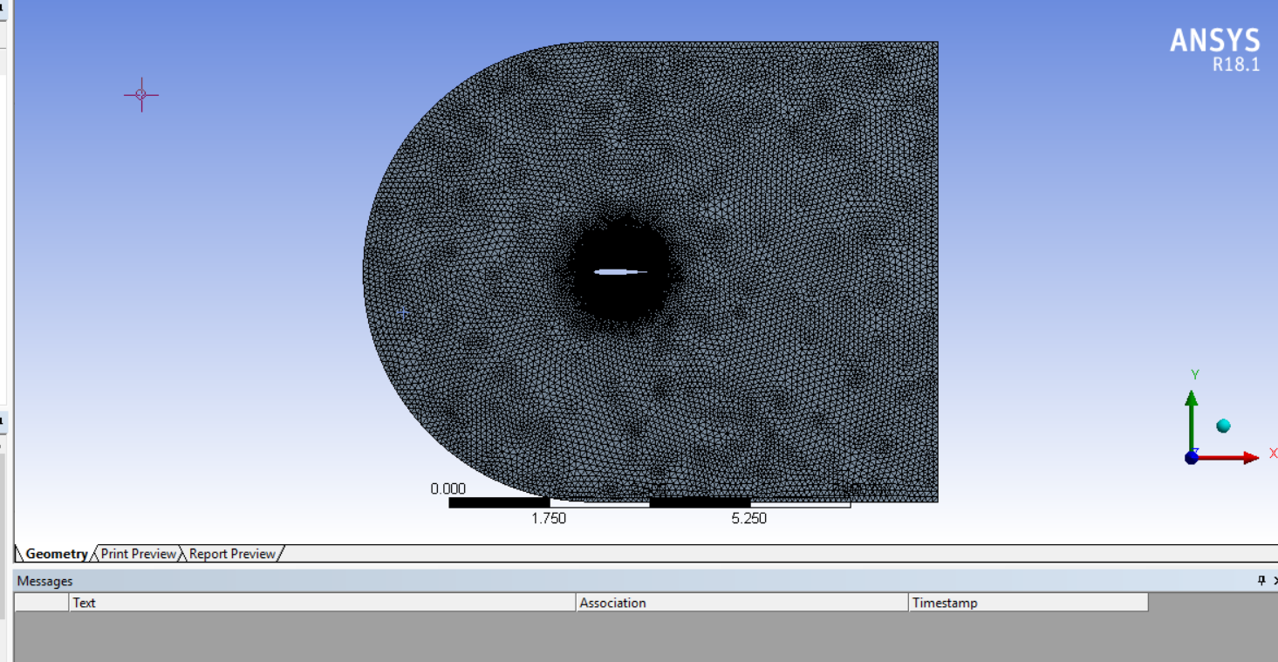
Creation of rotating airfoil geometry
Creation of meshing of rotating airfoil

Slide 12
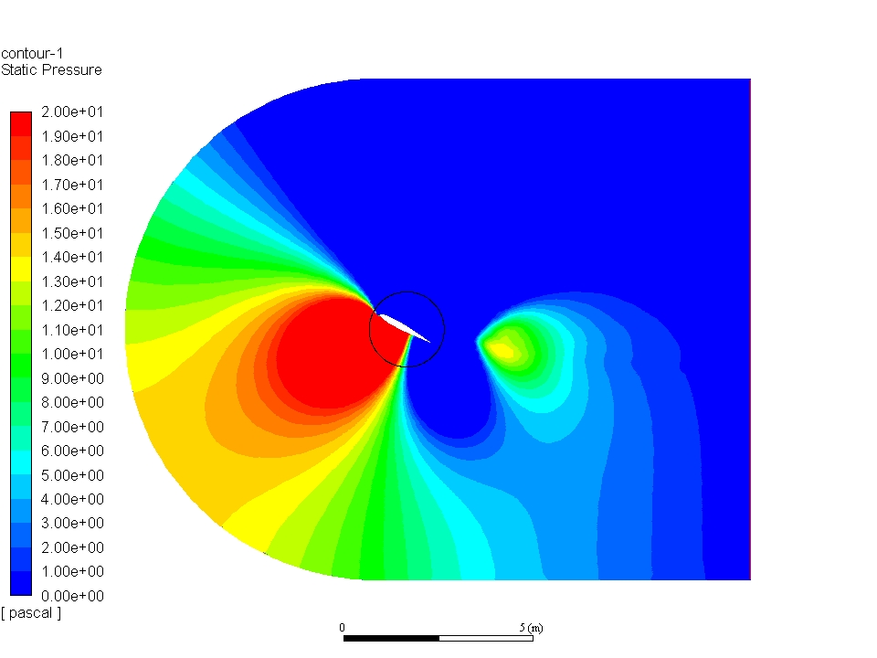
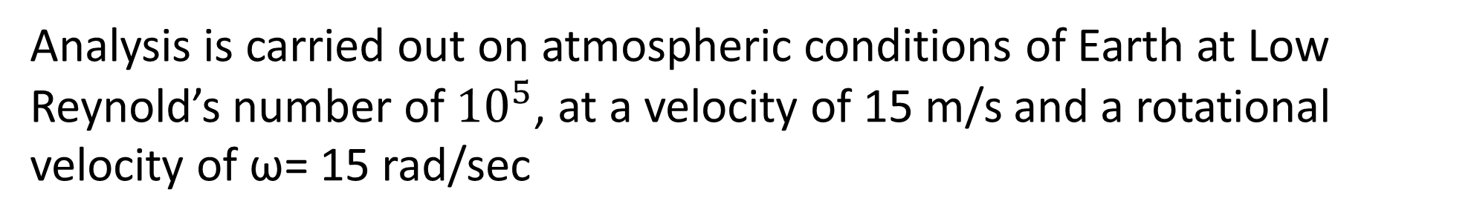
Analysis is carried out on atmospheric conditions of Earth at Low Reynold’s number of ${10}^{5}$, at a velocity of 15 m/s and a rotational velocity of ω= 15 rad/sec
Results obtained
Variation of static pressure

Slide 13
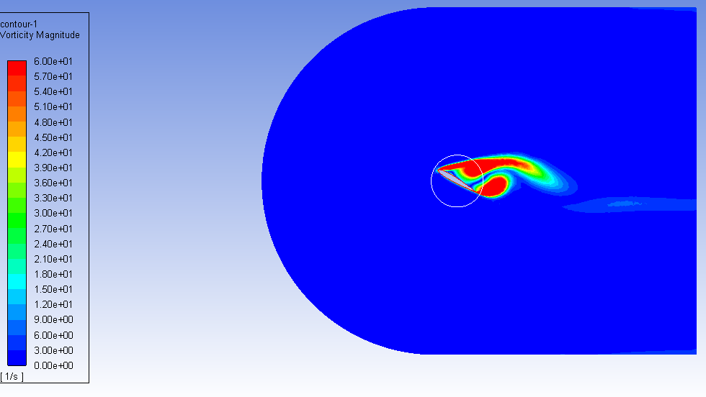
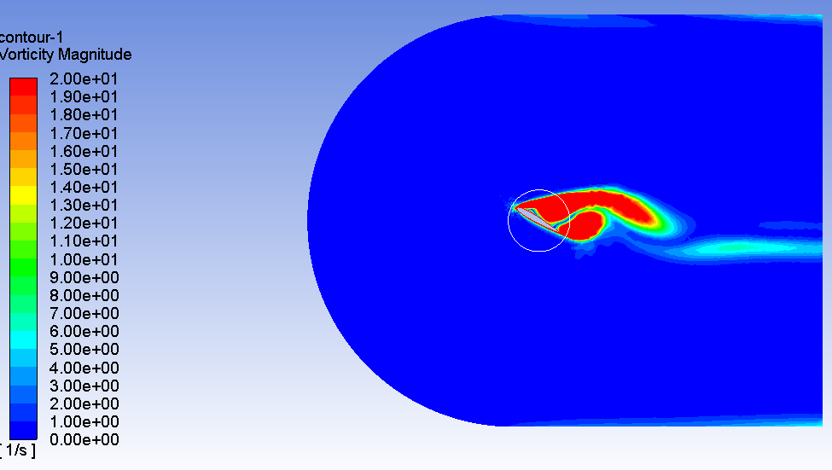
Results
Time step-up = 0.02 seconds
Time step-up = 0.023 seconds
AOA: 17.8 °
AOA: 19.7 °
Variation of vorticity

Slide 14
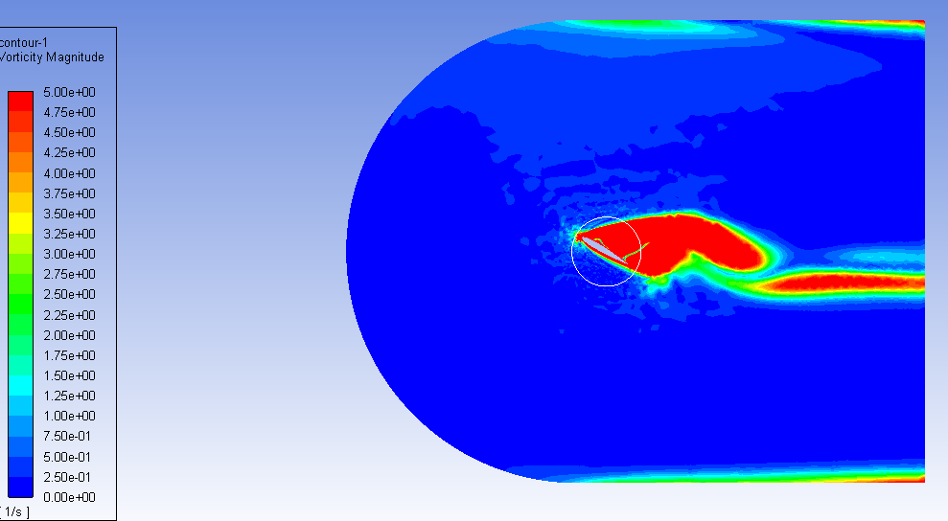
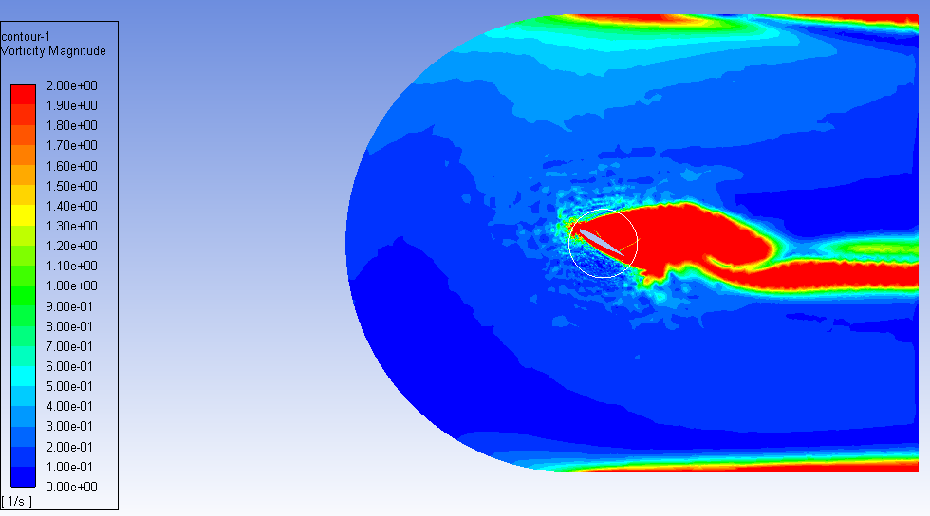
Results obtained
Time step – up: 0.025 seconds
Time step – up: 0.028 seconds
AOA: 21.4°
AOA: 24.06°
Variation of vorticity

Slide 15
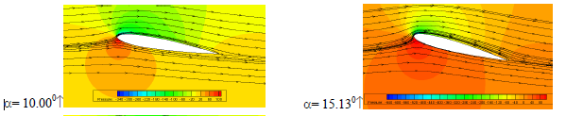
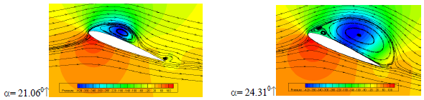
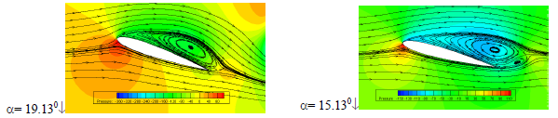
Comparative study of vorticity
Reference paper: Numerical Investigation of Dynamic stall Control

Slide 16
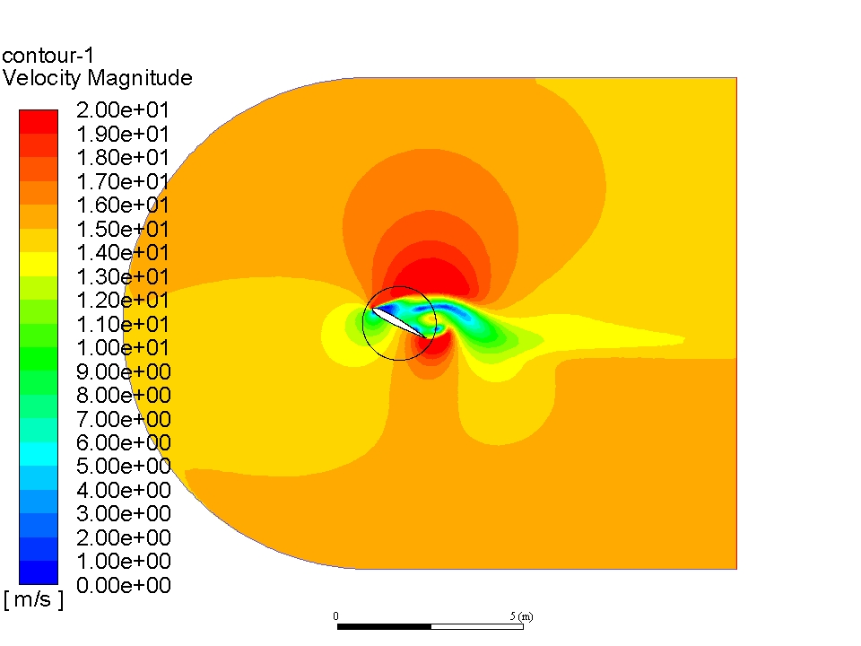
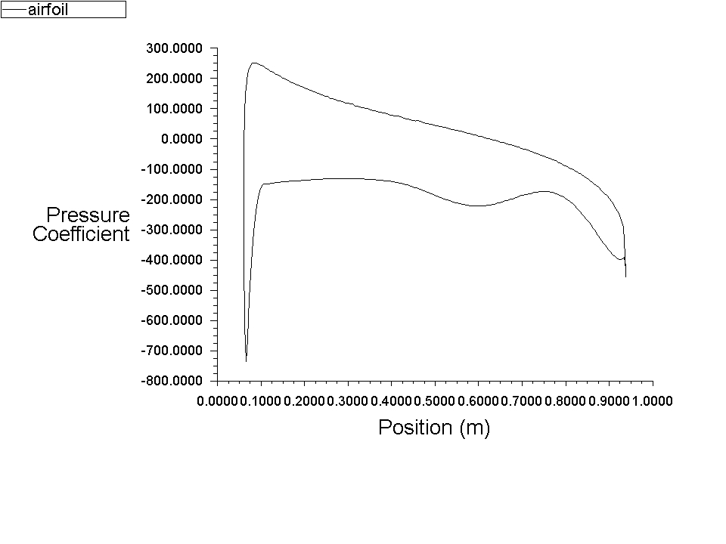
Results obtained
Variation of coefficient of pressure
Velocity magnitude variation

Slide 17
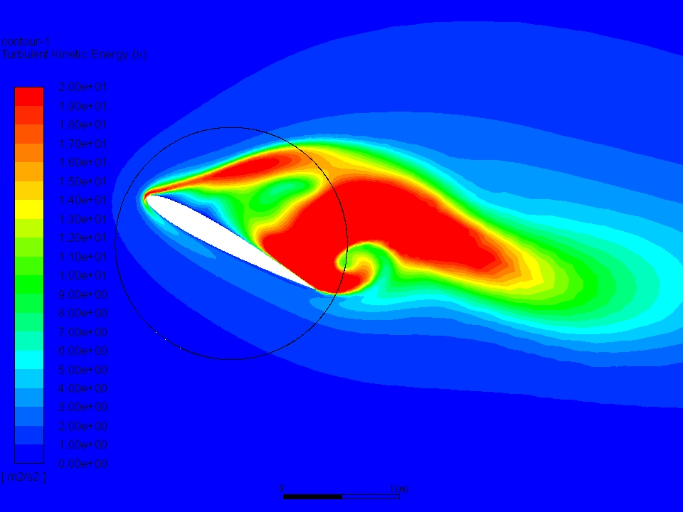
Results obtained
Variation of turbulent kinetic energy

Slide 18
References
[1] Mehta, U. B., 1978, ‘Dynamic Stall of an Oscillating Airfoil ‘, AGARD Unsteady Aerodynamics, pp. 1-32
[2] Tuncer, I., Wu, J., Wang, C., 1990, ‘Theoretical and Numerical Studies of Oscillating Airfoils’ AIAA Journal, 28(9), pp. 1615-1624
[3] Ekaterinaris, J., 1989, ‘Compressible Studies on Dynamic Stall’ AIAA 27th Aerospace Sciences Meeting Reno, NV
[4] Fung, K.-Y., and Carr, L., 1991, ‘Effects of Compressibility on Dynamic Stall,’ AIAA journal, 29(2), pp. 306-308
[5] Pietro Catalano,Renato Tognaccini, ‘Large Eddy Simulation of the flow around SD 7003 Airfoil’, Fluid Dynamics Laboratory, C.I.R.A, Italy

